Slide 1
Posture Corrector
The Nagging App
Mridul Mittal,
Student of Class 8
Phoenix Greens School Of Learning

Slide 2

TOPICS
Overview
How can we help?
Additional features
Privacy & Trust
Contribution to SDG
Future Plan’s

Slide 3
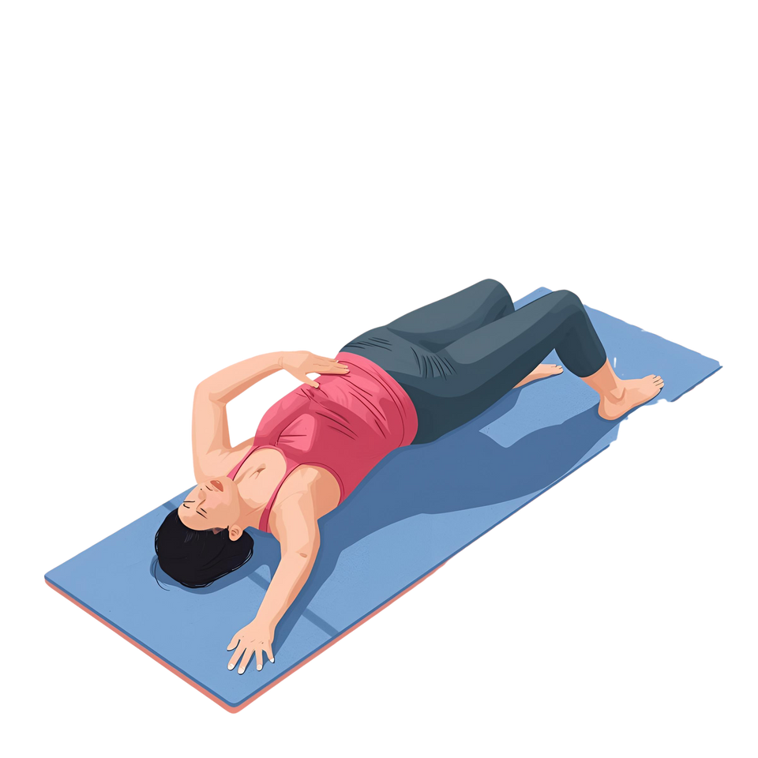
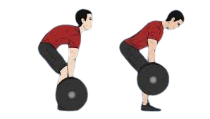
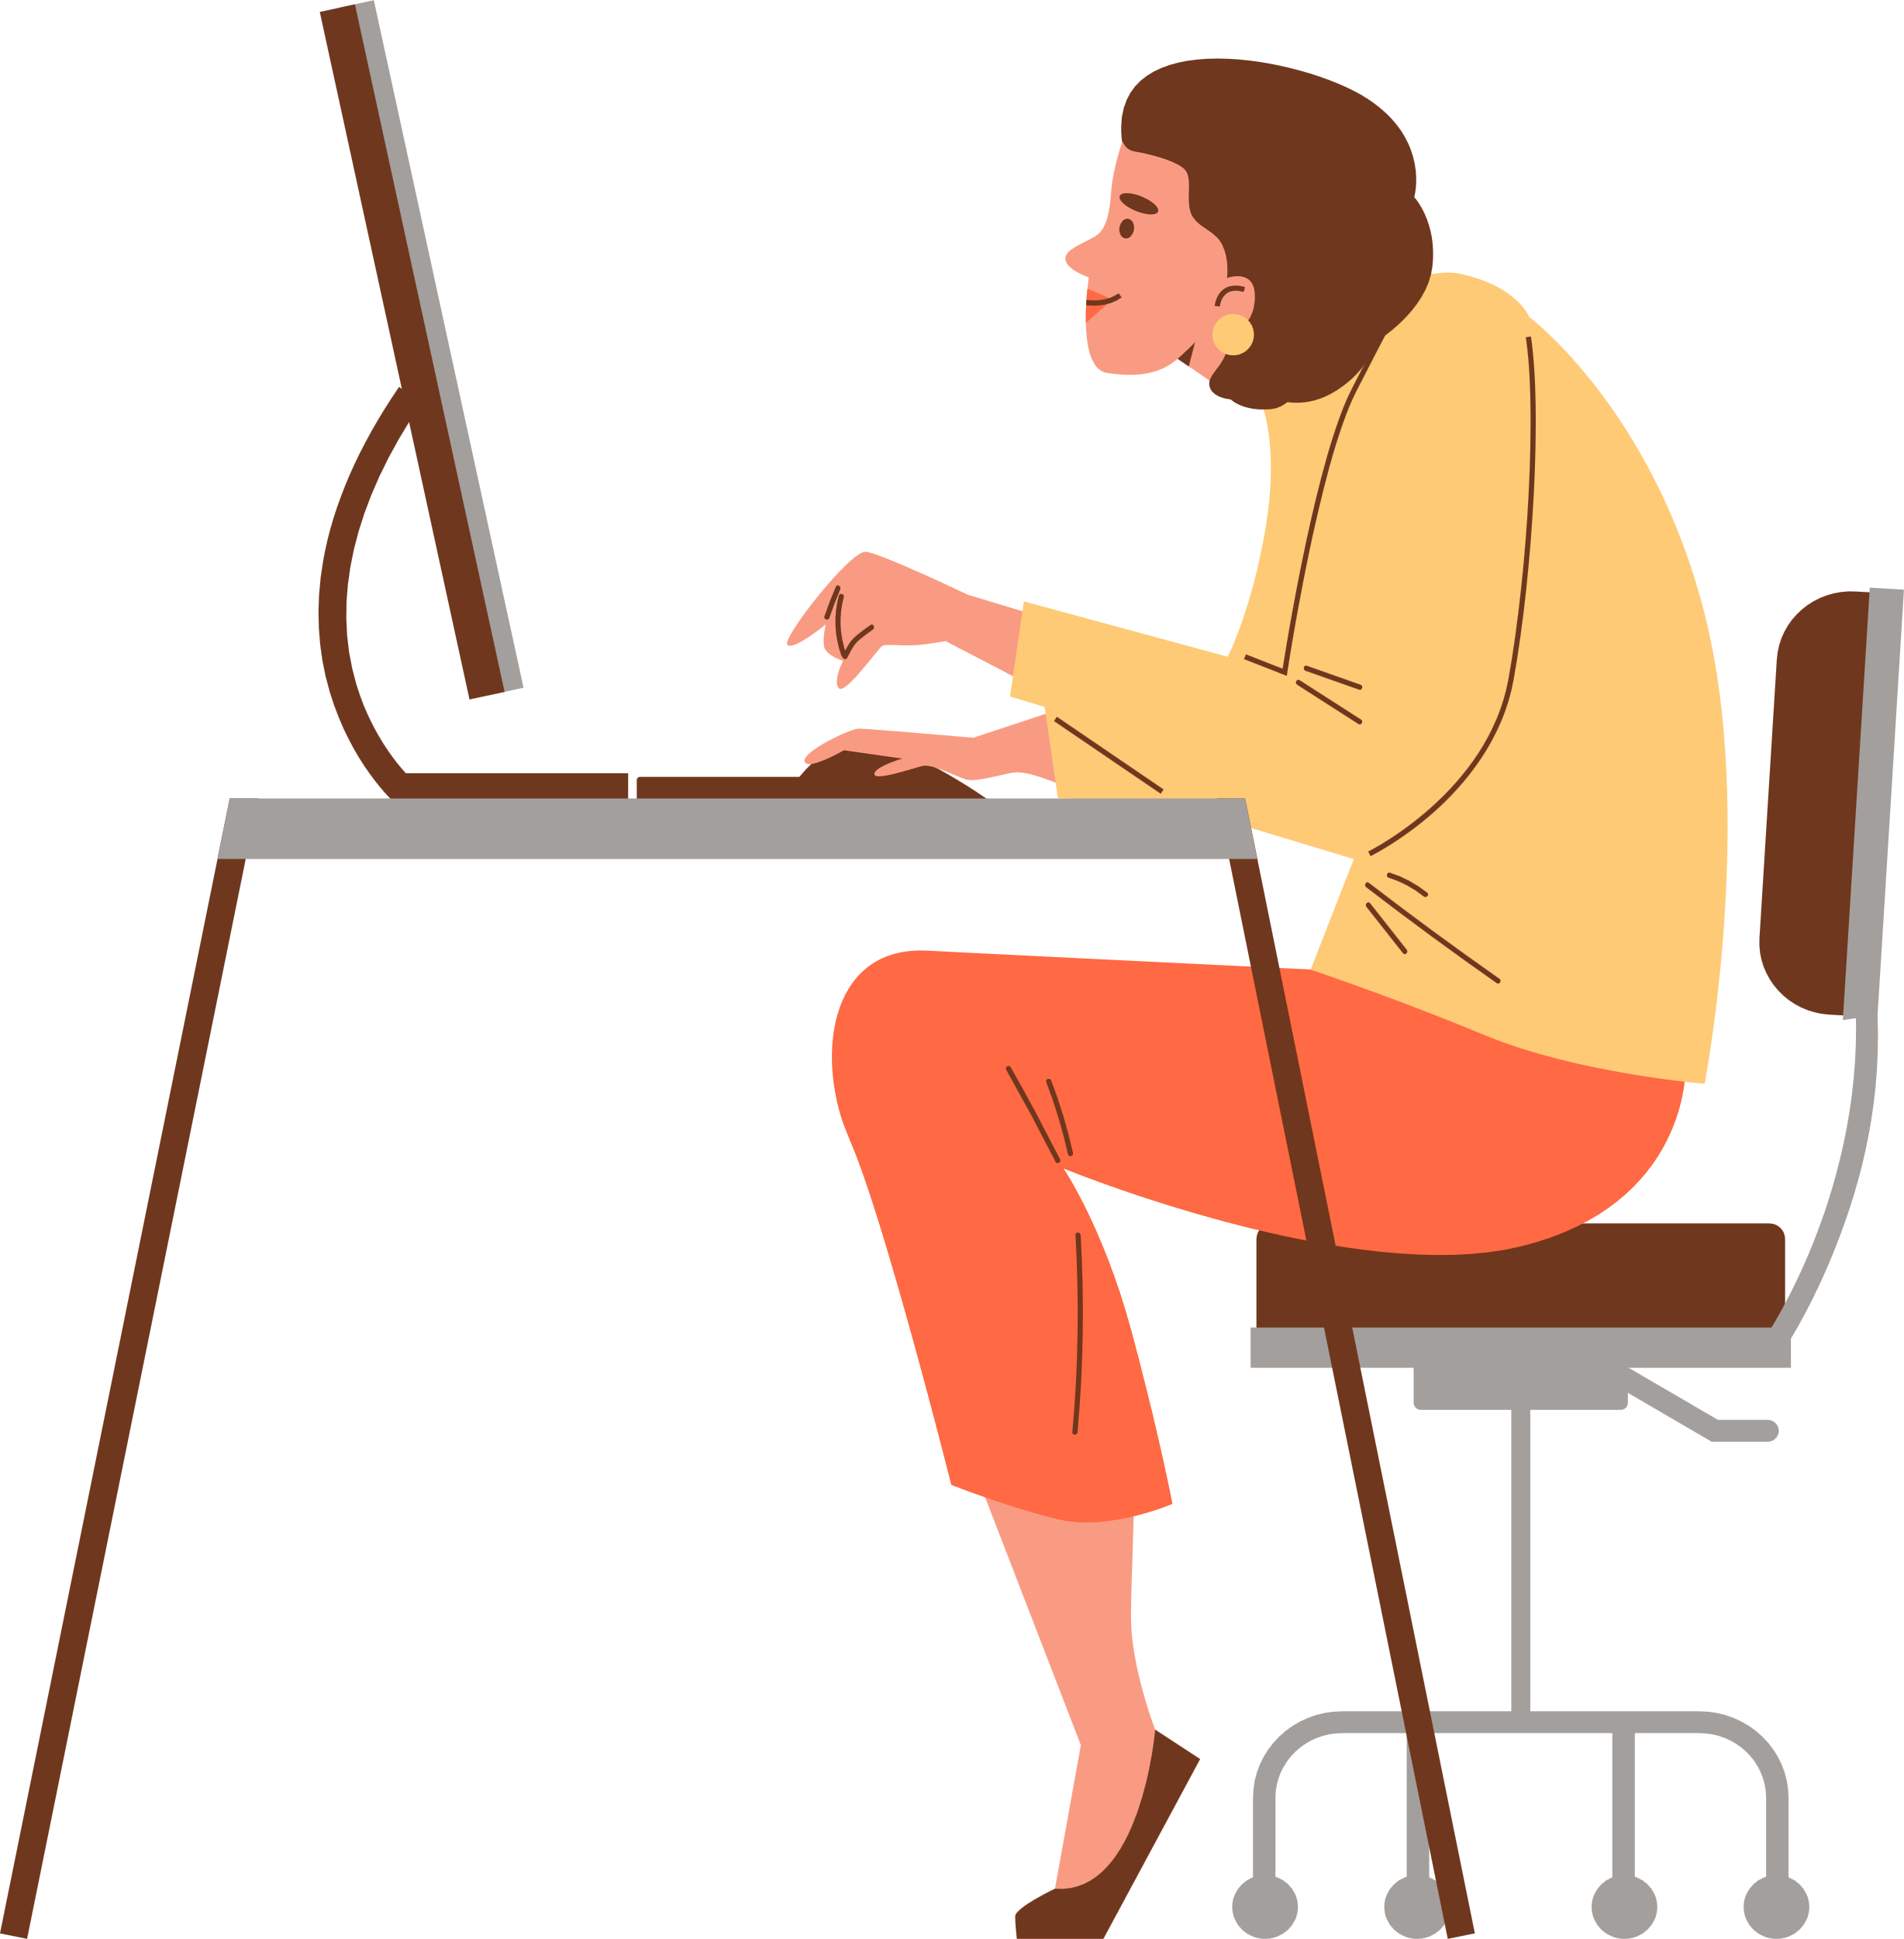
Overview
Urban professionals spend long hours seated—calls, emails, constant messaging.
Poor sitting posture develops gradually, often unnoticed.
Wrong exercise techniques or poses can worsen physical strain.
Both lead to long-term health problems, reducing well-being and productivity.
It impacts their overall health.

Slide 4
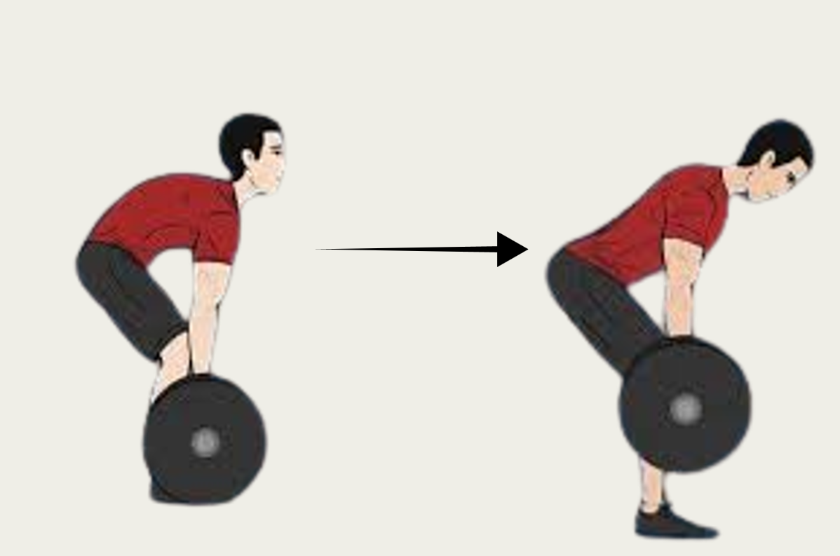
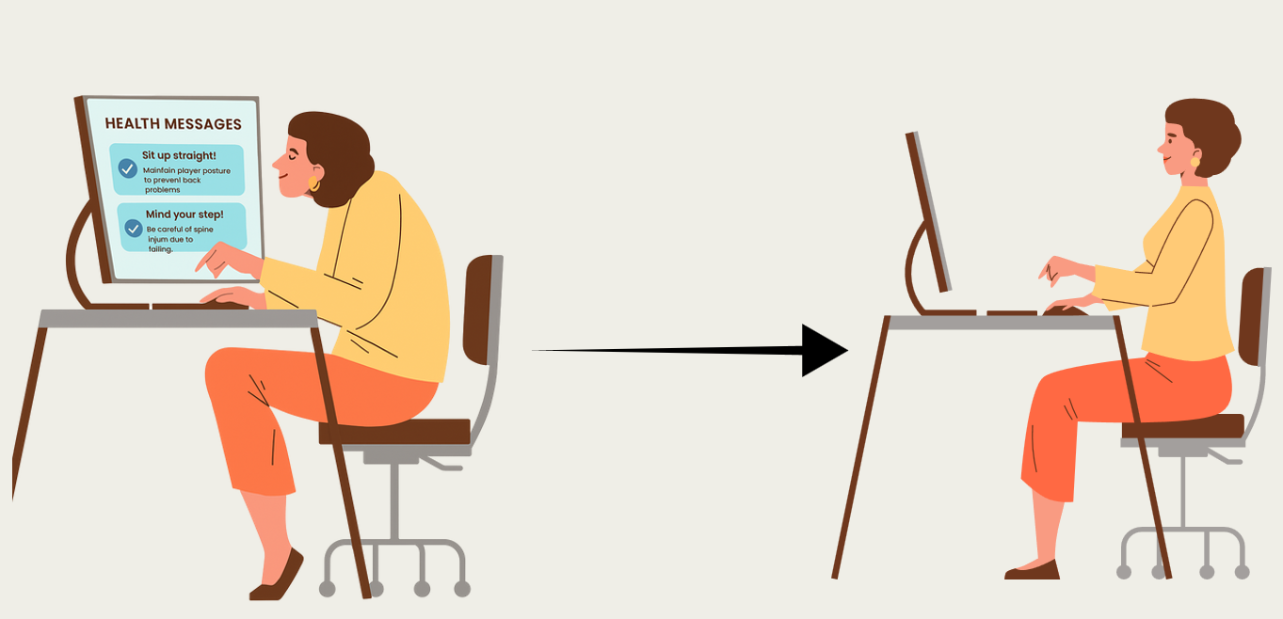
HOW CAN THE WE HELP?
Develop an AI-powered model with a large posture-tracking database.
Utilize the laptop or mobile camera to monitor posture throughout the day.
Provide real-time alerts when posture begins to slip.
Extend functionality to fitness environments for monitoring workout using mobile camera.
Help users prevent long-term health issues through timely corrections.

Slide 5

WHAT ADDITIONAL FEATURES CAN IT PROVIDE?
Leverage posture tracking to monitor user attentiveness during work or study.
Detect signs of distraction or lack of focus using AI analysis of posture data.
Provide personalized tips to improve concentration and attention span.
Offer actionable insights to boost productivity and focus throughout the day.
The system collects data only from reliable and trusted databases to ensure accuracy and safety for machine learning.

Slide 6
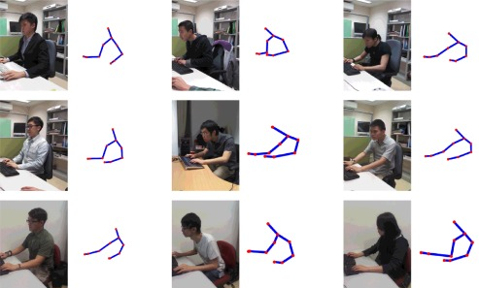
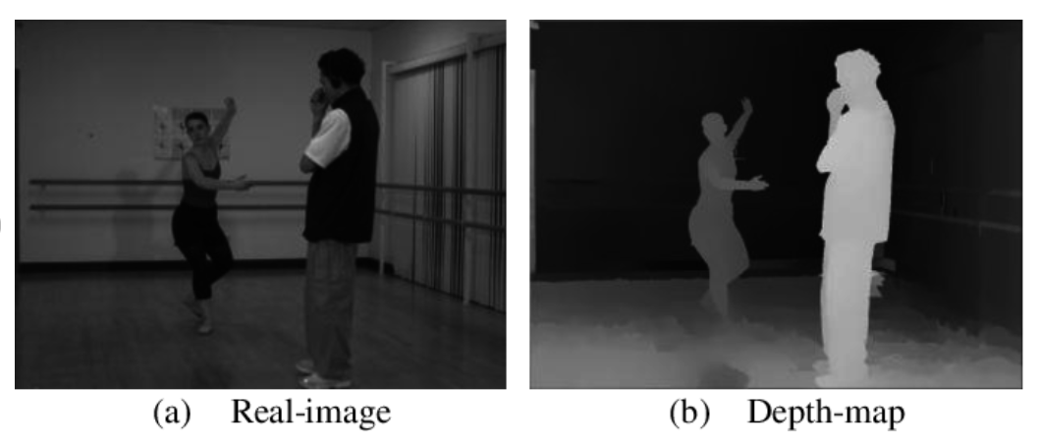

Privacy & Trust
All posture analysis happens on the user’s device using Edge AI; Camera real images are not uploaded to any server.
The app does not record or store photos or videos by default; frames are analyzed and then discarded instantly.
Only anonymous statistics (like number of posture alerts per day) are stored to help users track progress.
Users control permissions: they can pause monitoring anytime and can delete their posture data in one tap.
Designed to follow modern privacy regulations (consent, data minimization, and transparency) to keep users safe.
Real Image
Depth Map
Healthy Pose
Back Lean Pose
Neck Lean Pose
Privacy first design
Reference: Improving posture classification accuracy for depth sensor-based human activity monitoring in smart environments – ScienceDirect
Authors: Edmond S.L. Ho, Hubert P.H. Shum, Yiu-ming Cheung, Pong C. Yuen
Computer Vision and Image Understanding - 2016

Slide 7

Contribution to SDG
Supports SDG 3: Good Health and Well-Being by promoting safer and healthier office, study and workout habits.
Encourages proper sitting posture and ergonomic alignment, reducing the risk of back pain and muscle strain.
Minimizes physical discomfort and fatigue during long working hours.
Helps prevent long-term issues such as poor circulation, eye strain, and repetitive stress injuries.
Enhances overall productivity and focus through a more comfortable and health-conscious workspace.

Slide 8

Future Plan’s
Develop Mobile and Laptop App using device camera for posture monitoring and real time alerts.
Implement an AI model and train it using trusted and reliable data sources.
Include work, study and workout postures.
Enhance it for detecting signs of distraction or lack of focus.
Include statistics to help analyze day-to-day progress in posture correction.

Slide 9


QUESTION AND ANSWER
Please feel free to ask questions

Slide 10
Thank you!
Mridul Mittal,
Student of Class 8
Phoenix Greens School Of Learning

